Slide 1
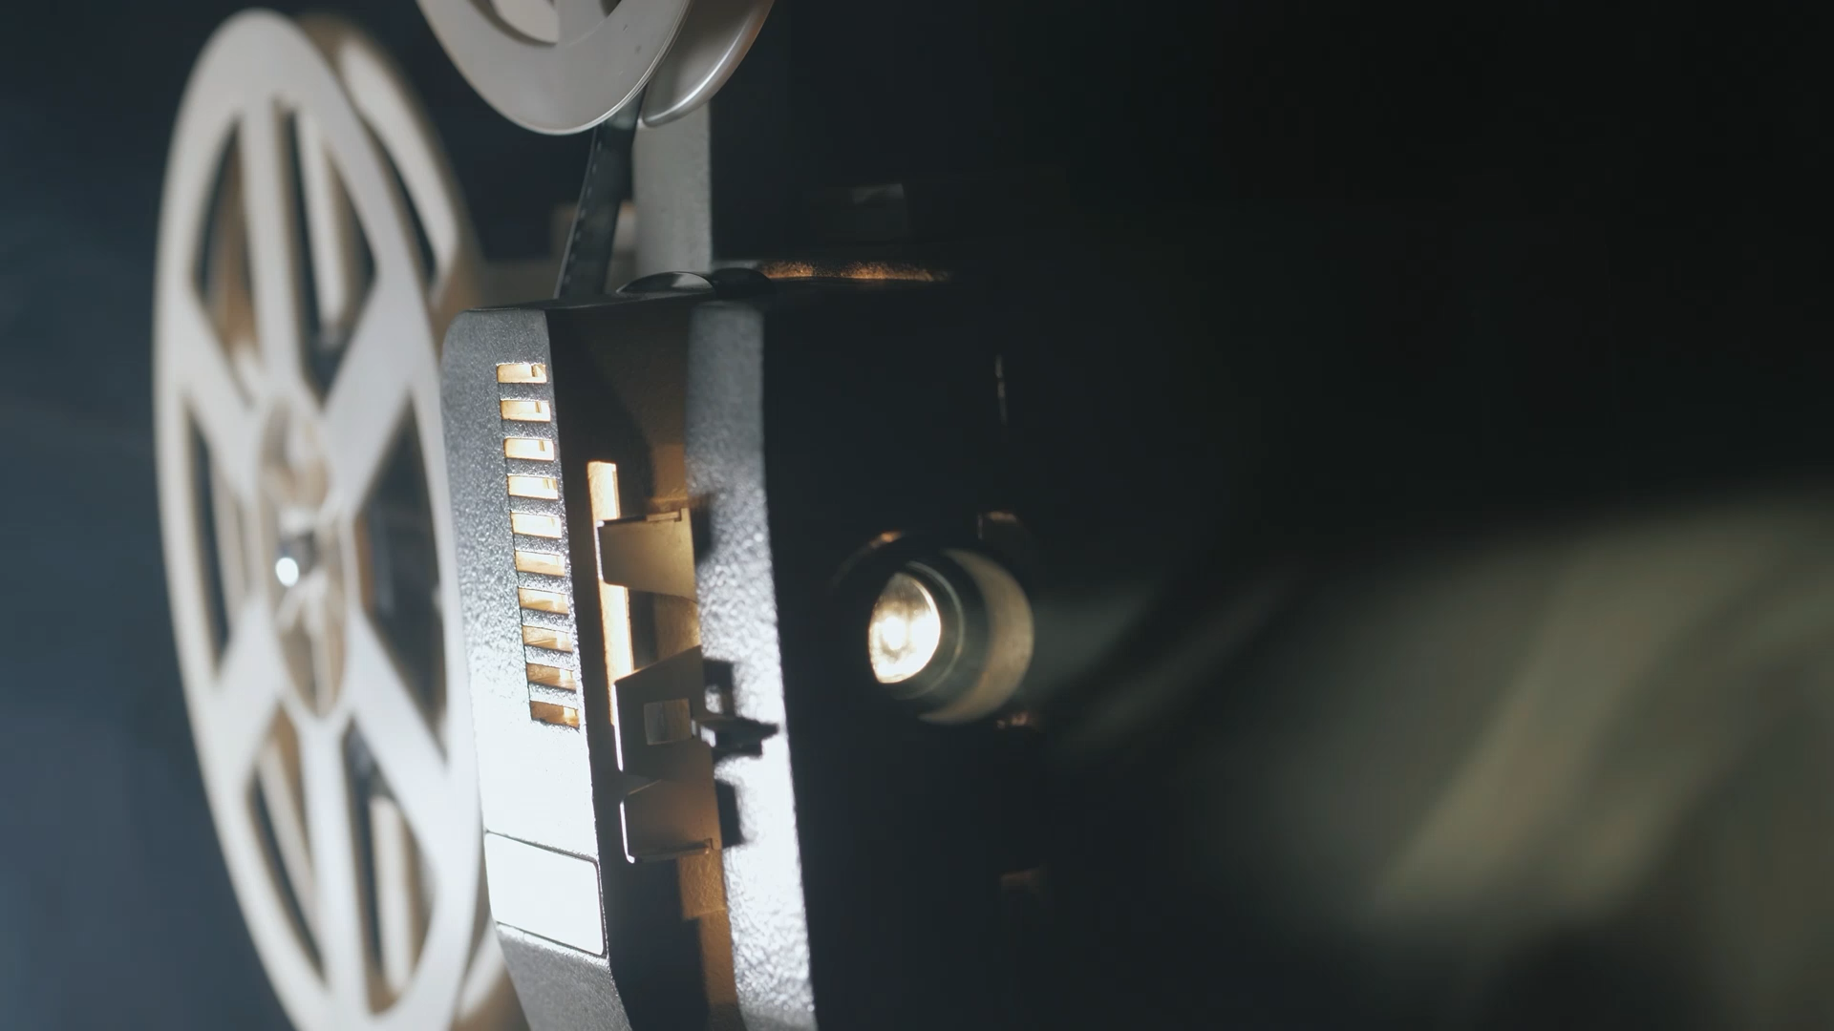
Technology In Film Production (Virtual Production in the Mandalorian) Date: 10/24/25 CSIT 100_04 FA 25
By,
Raj Mehta

Slide 2
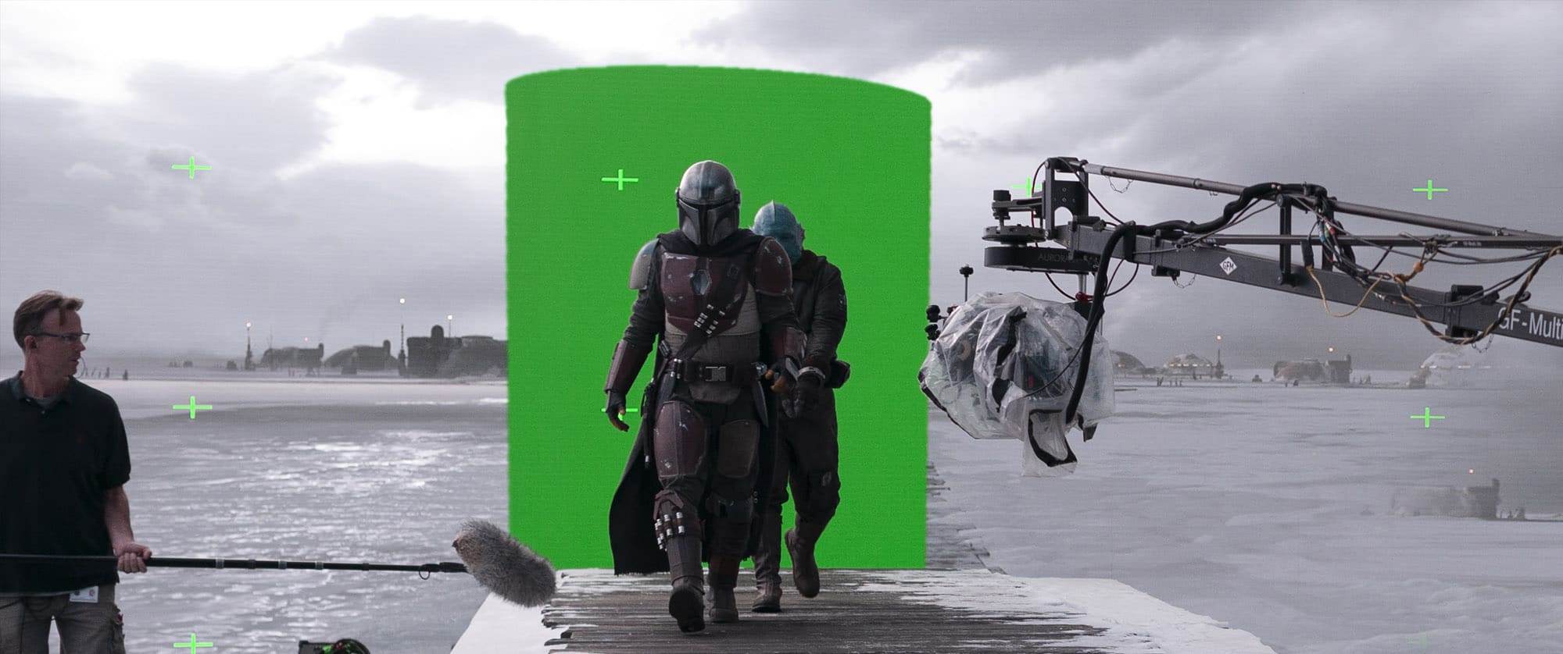
Hyperreality
In virtual film making “Hyperreality”, is a strong component needed for maximum film efficiency.
Hyperreality defined, “Is any state in which a human consciousness can no longer differentiate the real from a simulation of the real.” [WRAPBOOK]
In other words, hyperreality is the “unreal real” Hyperreality is another strong component needed for maximum film efficiency.
The valley of “Is” a “made up” or Uncanny valley created in the production of The Mandalorian. “Is” is not on any map, but it is an unreal world made up in The Mandalorian that features characters as humans, robots and alley cats that are digitally created to look real but who are, in fact, not real.

Slide 3
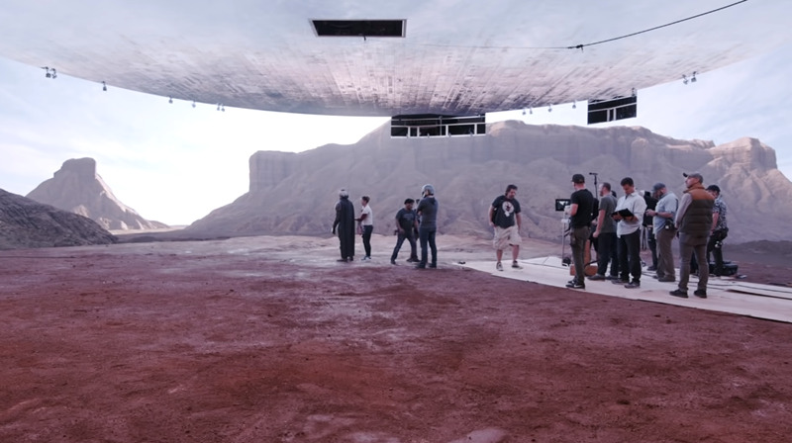
LED Volume Technology/ Screens
Hyper reality uses LED Volume Technology.
It is a layout of massive LED Walls which are also screens. They are referred to as “The Volume” a backdrop if you will.
The way this works is the image of the backdrop is projected on to the LED screen.
This goes hand in hand with what the actor or actors are doing in the scene which makes the audience believe that the actor or actors are actually “on site”.

Slide 4
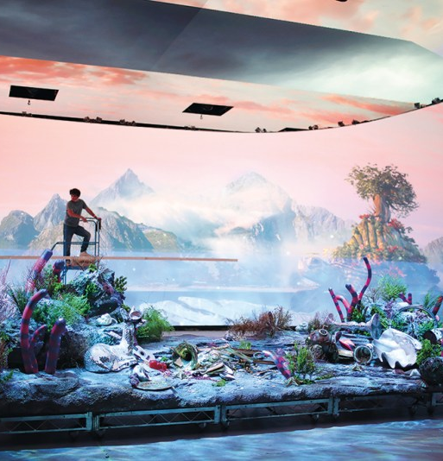
LED Volume (LED Screens) Versus Green Screens.
The differences between LED Screens and Green Screens and the benefits of both are significant.
One component is scenery. In LED the background is created by projecting the screen while the construction of the many physical sets is required at the shooting site or sites.
This cost money and time which are not seen in Volume Technology using LED screens. Now the lighting is another aspect.
LED walls create more realistic colors and reflections. While with the Green Screen Technology the green is removed then a new background is created which sometimes results in unnatural lighting.
This shows the quality of the final product produced by Volume Technology is better and more realistic than Green Screen Technology. Performance is another aspect.
With the LED wall, the actors can see their performance in context of the setting and make changes as needed. The actors must use their imagination with the Green Screen to make it look like they are where they’re supposed to be in the scene they’re filming,
Just while using the screen and nothing else, like other set pieces or props. This could lead to more scene takes and is inefficient.
Last, but not least, there is the cost. LED screens are less expensive as they don’t require set builds as used in Green Screens.

Slide 5
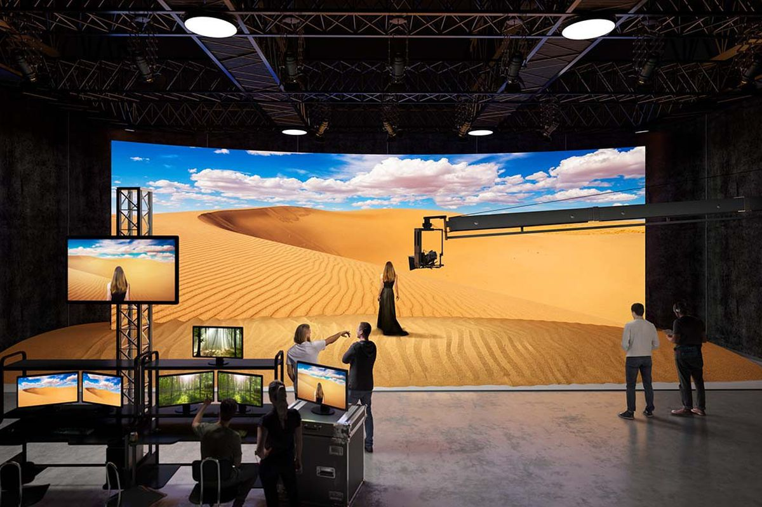
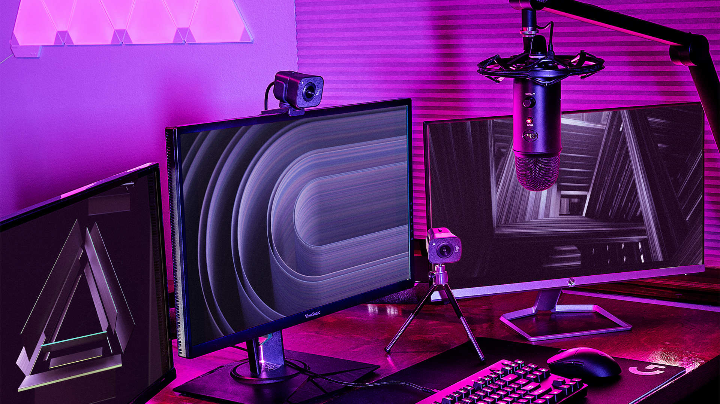
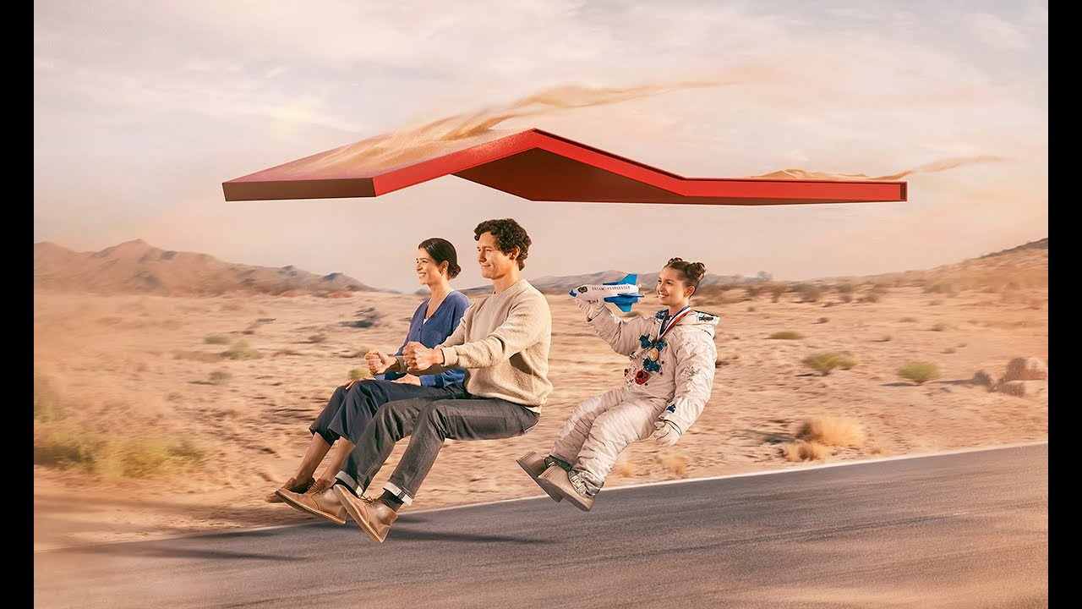
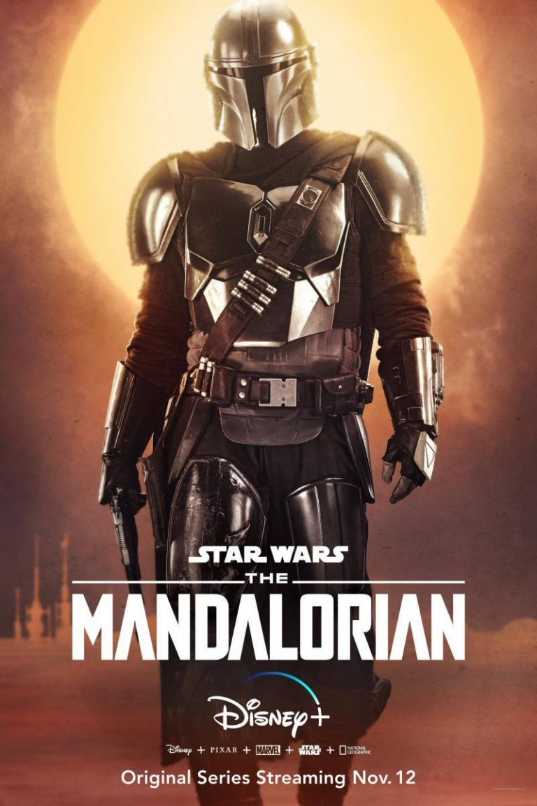
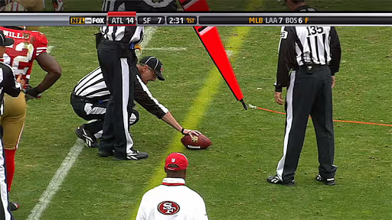
Other uses of LED Volume Technology.
LED Volume Technology is not only used in films.
It is also used in commercials.
It is also used telecasting sporting events.
Also, for YouTube gaming steamers.
This Photo by Unknown Author is licensed under CC BY-SA-NC

Slide 6
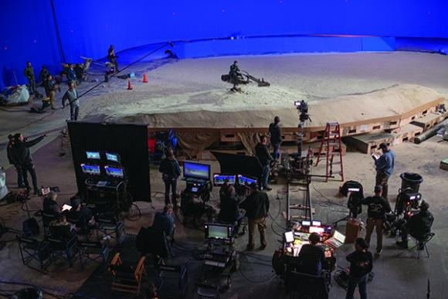
The impact of LED Screens on The Mandalorian
The second component is LED Volume Technology. It is a layout of massive LED Walls which are also screens. They are referred to as “The Volume” a backdrop if you will.
The way this works is the image of the backdrop is projected on to the LED screen.
This goes hand in hand with what the actor or actors are doing in the scene which makes the audience believe that the actor or actors are actually “on site”.
In a scene in the Mandalorian, we see the Mandalorian is standing on a heap of sand looking out for his next bounty.
In actuality the Mandalorian is standing in a LED room.
The scene that the audience sees is digitally inserted, making the audience believe that he is actually in a dessert.

Slide 7
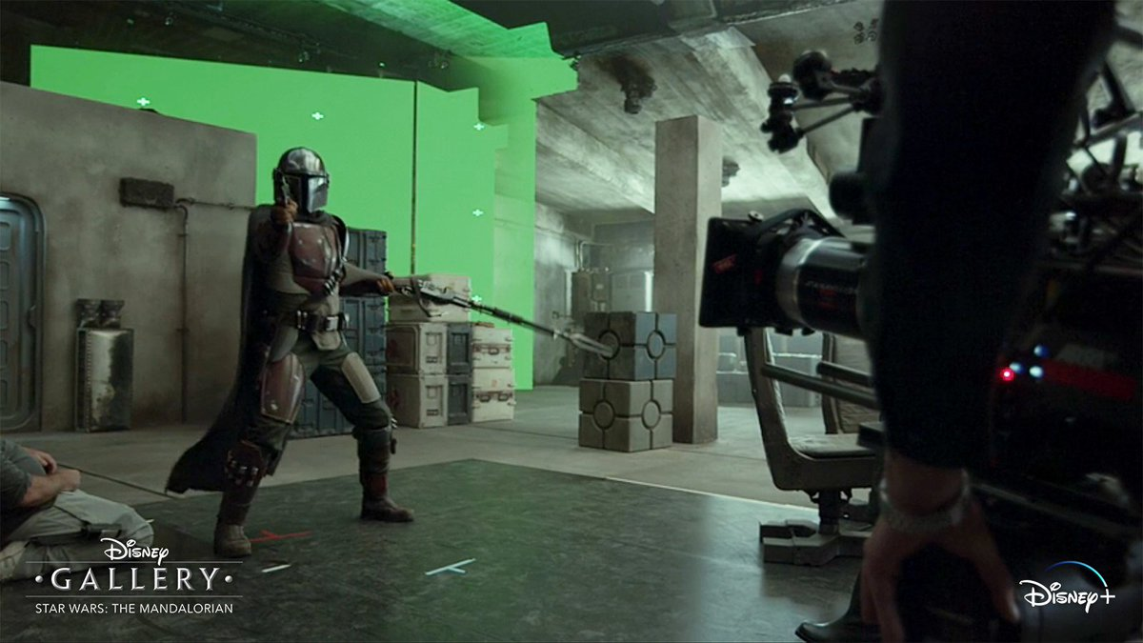
Green Screens
The Green Screens require more set building, more time which slows down production and adds more expense to the filming.
This shows that the Volume Technology is not only efficient process, but also saves money, then other film technologies. [Bad Decisions Podcast] and [UNIT].
Although it may be expensive to set up studios with LED Walls and equipment, they are reusable for other productions, saving money in the long run.
This is not possible with Green Screen Technology because each production with new and sometimes multiple sets are used increasing costs on materials.

Slide 8

The Cost-effectiveness of its use
The overall cost of implementing LED Wall technology in studios exceeds $100 million.
This cost is incurred for screens, camera equipment, rendering engines, virtual backgrounds and motion capture, equipment to name a few.
[UNIT] Although it may be expensive to set up studios with LED Walls and equipment, they are reusable for other productions, saving money in the long run.
This is not possible with Green Screen Technology because each production with new and sometimes multiple sets are used increasing costs on materials.
Another cost saving aspect is props that are used in films. With LED Volume props can be digitally inserted in a scene but in Green Screen sets props must be purchased and then used, increasing costs of the production. [UNIT].

Slide 9
Collaboration, Lucasfilm, Disney, Unreal Engine, etc.,
The overall cost of implementing LED Wall technology in studios exceeds $100 million.
This cost is incurred for screens, camera equipment, rendering engines, virtual backgrounds and motion capture, equipment to name a few. [UNIT]
Although it may be expensive to set up studios with LED Walls and equipment, they are reusable for other productions, saving money in the long run.
This is not possible with Green Screen Technology because each production with new and sometimes multiple sets are used increasing costs on materials.
Another cost saving aspect is props that are used in films. With LED Volume props can be digitally inserted in a scene but in Green Screen sets props must be purchased and then used, increasing costs of the production. [UNIT].

Slide 10
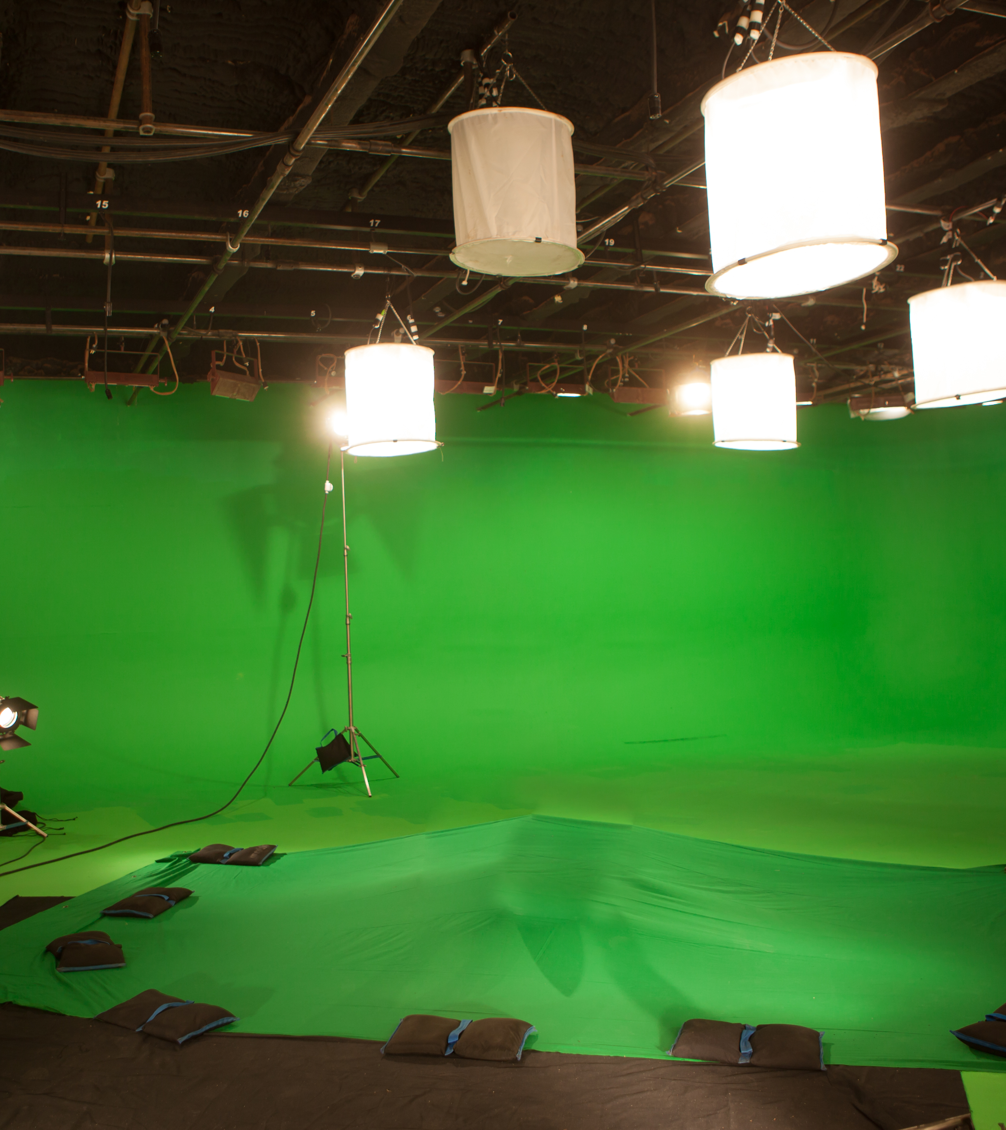
The impact on The Mandalorian
The Volume technology invented, is used to give a full panoramic view, using a wraparound array of screens.
When using The Volume, in the long run, budgets will likely show the benefits of virtual production and LED Volume Technology.
The expenses for sound stages and platforms will be less expensive than how films used to be produced.
As time goes on, and as our understanding of this technology grows, it will be more cost-effective and virtual production practices will naturally increase, leading to a more cost-effective, efficient and a better product.

Slide 11
Unreal Engine
Some companies that worked on the Mandalorian used a tool called “Unreal Engine”, this was and still is a gaming software engineering site and the tool used for not only gaming animation, but film animation as well and just all things 3D creation animation. In “The Mandalorian”, the animation teams come together to design all the characters and animatronics used throughout the duration of each episode. In The Mandalorian,
Unreal Engine also helps them to visualize spaces and products. Since, the production has no physical location needs to be chosen, it helps speed up the production times. This also helps the teams create advanced interfaces which in turn, helps to push production ahead of the initial release schedule. [Unreal Engine] and [WRAPBOOK]
In the “Virtual Production with Unreal Engine, Felix Jorge” and “Bad Decisions Podcast”, the podcast hosts, Farhad and Faraz interview Felix Jorge and talk about the LED technology used on the Mandalorian. [Bad Decisions Podcast] Felix has worked with John Favreau and his team on the production of “The Lion King” in addition to the Mandalorian.
Felix explains that he was a part of the production team where he brought his expertise, from working on gaming engines to make the visual aspect of the show more real or life-like.

Slide 12

Teams and Collaboration
With LED Volume props can be digitally inserted in a scene but in Green Screen sets props must be purchased and then used, increasing costs of the production. [UNIT]
Although there is no consensus about the “perfect volume team” collaboration is a crucial part of virtual film production [WRAPBOOK] and [Bad Decisions Podcast]
John Favreau said in a video featured on Wrap Box, that his film company has collaborated with Disney, Epic Games, Lucas Films and many others, when working on the Mandalorian

Slide 13
So, to sum up…
In conclusion, Virtual Film Production is the integration of film industry technology and gaming engines.
With virtual production film maker are creating experiences which cause viewers to question the “real” versus the “unreal”.
The film that the audience sees makes them question whether its real or unreal.
The films produced with LED Technology is very well made that it is difficult to single what is digitally inserted and what is really…real.

Slide 14
Citations/ References
Wrap Book: https://www.wrapbook.com/blog/virtual-production-mandalorian-technology-new-frontier
UNIT: https://www.unit-led.com/mandalorian-led-wall
YouTube Podcast: https://www.youtube.com/watch?v=IPod35eA8Rc&t=5291s
YouTube: The Virtual Production of The Mandalorian Season One
YouTube: https://www.youtube.com/watch?v=aKRcGoc_osQ
Fx guide:
https://www.fxguide.com/fxfeatured/art-of-led-wall-virtual-production-part-one-lessons-from-the-mandalorian/
IATSE Local 695:
https://www.local695.com/magazine/mixing-the-mandalorian-season-one-this-is-the-way/
GamesRadar:
https://www.gamesradar.com/streaming-for-gamers/

